Slide 1
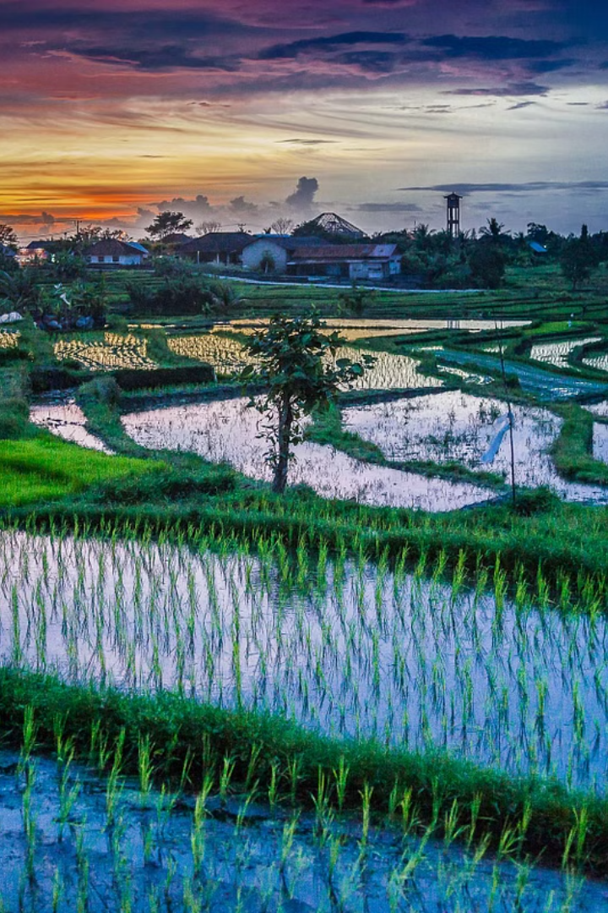
Predicting Rice Diseases Using CNN-Based Machine Learning
Rice is a vital staple food for billions worldwide. However, diseases threaten its production, causing significant yield losses. This presentation explores a CNN-based approach to automate rice disease detection, improving food security and farmer livelihoods.
The project was conducted by Amulya Javvaji, under the guidance of Ms. V. VedaSri at SRM UNIVERSITY AP.

Slide 2
The Challenge of Rice Diseases
Staple Crop Under Threat
Traditional Methods Fall Short
Rice is a crucial source of sustenance, feeding a large portion of the global population. Its production faces challenges from diseases like rice blast, brown spot, and bacterial blight, leading to substantial yield losses and economic hardship for farmers.
Traditional disease identification methods rely on visual inspection, which is time-consuming, subjective, and prone to errors. Early detection is crucial for effective treatment, highlighting the need for a more reliable and efficient solution.

Slide 3
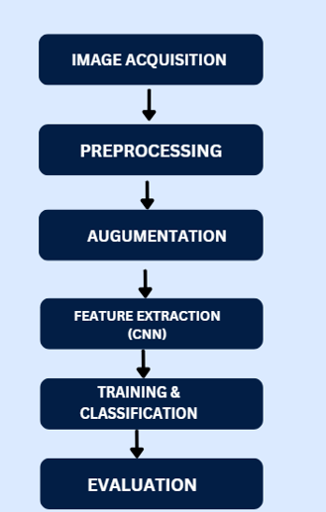
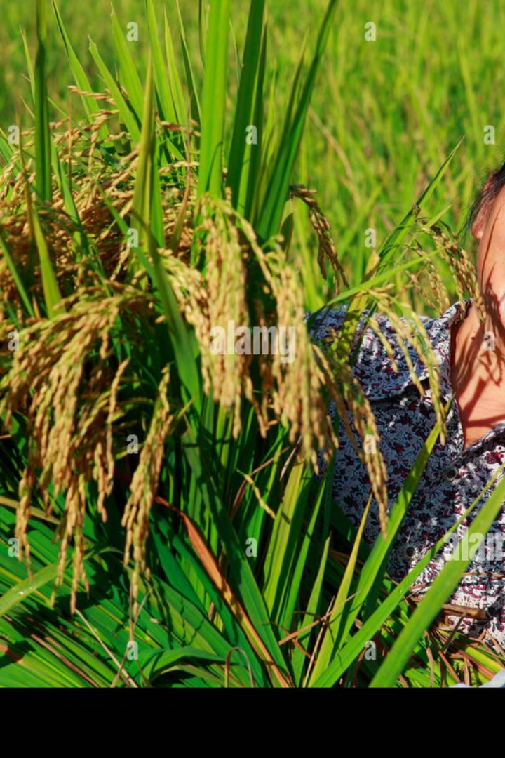
Objective: Accurate and Scalable Disease Detection
1
Automated Detection
2
Early Identification
Our objective is to develop a CNN-based system for automated rice disease detection, providing farmers with a cost-effective and scalable solution.
By enabling early and accurate disease identification, we aim to improve rice yields and minimize the impact of diseases on farmers' income.
3
Food Security
Through timely intervention, we contribute to ensuring food security by protecting rice production from disease-related losses.

Slide 4
Dataset Preparation and Preprocessing
Dataset Description
Preprocessing Steps
The dataset comprises images of rice leaves under various conditions, including healthy leaves and leaves affected by different diseases. This data is collected from research institutions and farmers, capturing real-world scenarios.
The images are preprocessed to ensure consistency and improve model performance. This includes resizing to uniform dimensions, normalization of pixel values, and data augmentation techniques like rotation, flipping, and zooming. Additionally, we address class imbalances to prevent biased model training.

Slide 5
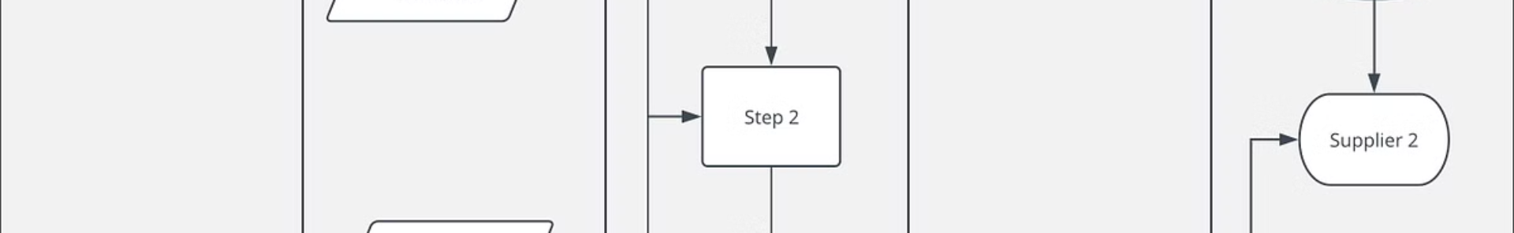
Methodology: CNN Architecture for Disease Classification
Image Input and Preprocessing
Disease Classification
Images of rice leaves are fed into the system and undergo preprocessing, including resizing, normalization, and augmentation.
The output of the CNN provides a classification of the input image, indicating whether the leaf is healthy or affected by a specific disease.
1
2
3
Convolutional Neural Network
A CNN architecture is used to extract features from the images, learning patterns associated with different rice diseases. This includes convolutional and pooling layers for feature extraction and fully connected layers for classification.

Slide 6
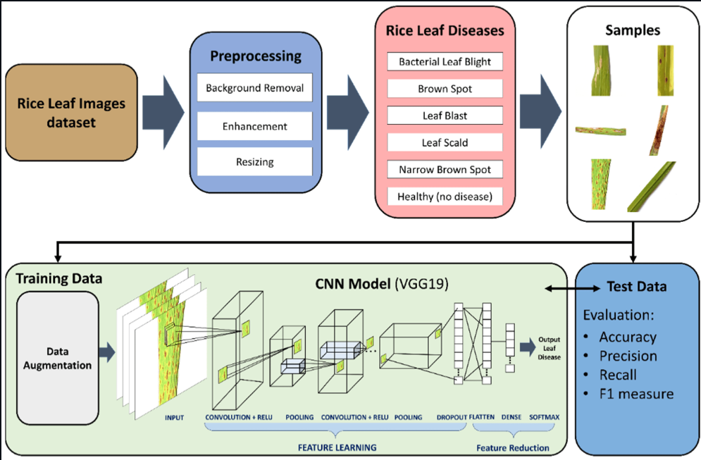
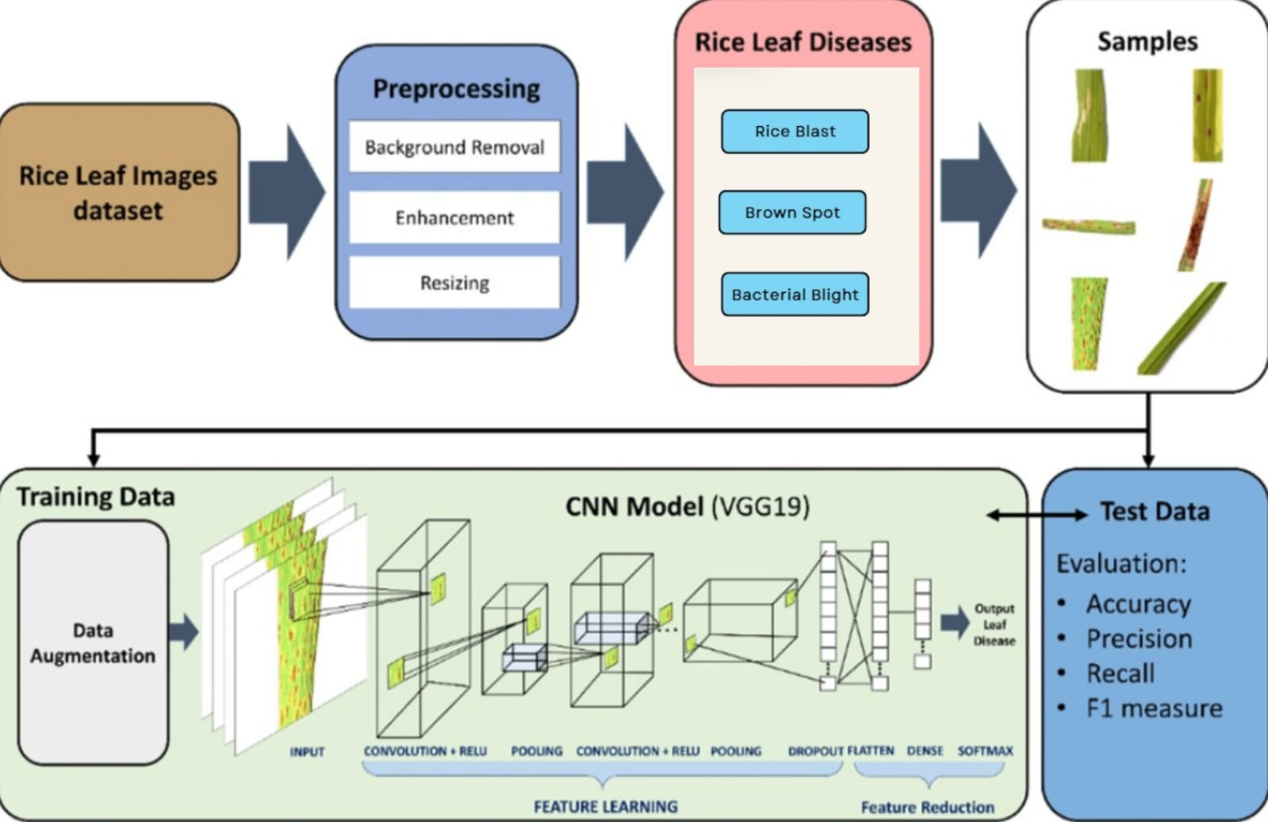

Slide 7



Model Training and Evaluation
Optimization Techniques
1
Dropout and regularization techniques are employed during training to prevent overfitting and enhance model generalization.
Hyperparameter Tuning
2
Hyperparameters, such as batch size and learning rate, are optimized to achieve the best performance on the training data.
Evaluation Metrics
3
The model's performance is evaluated using metrics like accuracy, precision, recall, F1-score, and ROC-AUC score, providing a comprehensive assessment of its reliability and effectiveness.

Slide 8
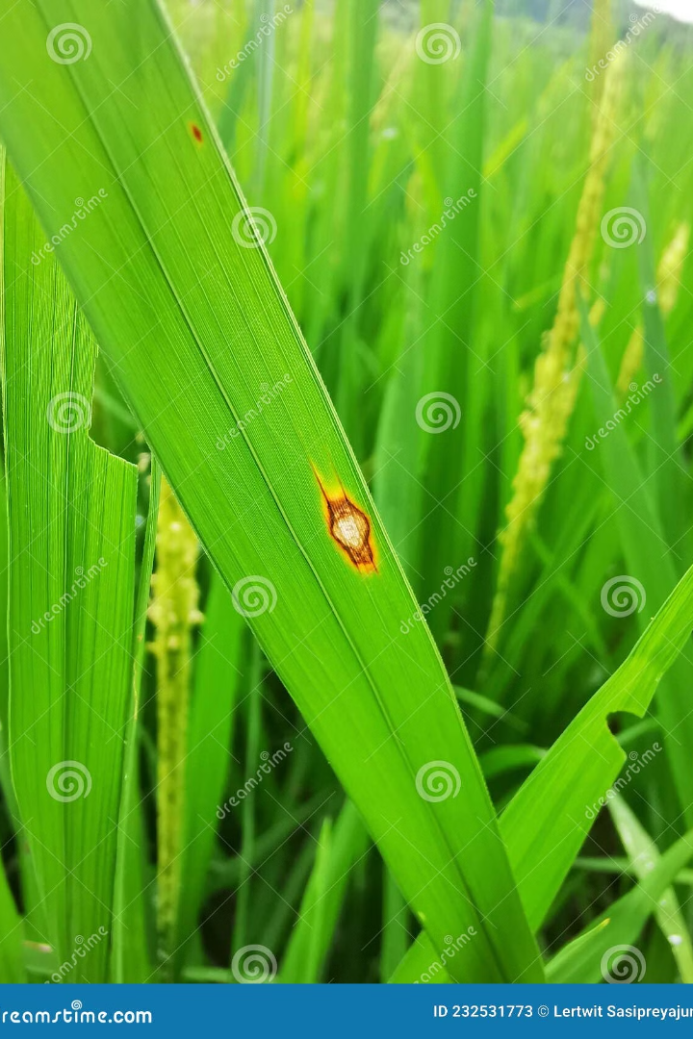



Results: High Accuracy and Visualization
Model Performance
The trained CNN model achieves an accuracy exceeding 84% in classifying rice diseases, demonstrating its effectiveness in identifying disease-affected leaves.
A state-of-the-art deep learning model pre-trained on ImageNet, known for its efficiency and accuracy in extracting rich features using convolutional layers and inception modules, ideal for image classification tasks.
Challenges
Challenges include the misclassification of visually similar diseases like brown spot and bacterial blight, which necessitates further research and data augmentation to address these ambiguities.

Slide 9
Limitations and Future Directions
Dataset Diversity
1
The current dataset may lack diversity in terms of rice varieties, environmental conditions, and disease variations, limiting the model's generalizability to different regions and scenarios.
Computational Resources
2
Training and deploying the CNN model may require significant computational resources, potentially hindering its accessibility for resource-constrained farmers.
Future Scope
Future directions include expanding the dataset to encompass diverse conditions, developing lightweight models suitable for mobile and edge devices, and integrating the system with IoT for real-time monitoring of rice fields.
3

Slide 10
Applications and Impact: Transforming Agriculture
1
2
3
Precision Agriculture
Benefits for Farmers
Reduced Reliance on Manual Inspection
The technology has the potential to be deployed in precision agriculture, allowing farmers to monitor their crops with increased accuracy and intervene efficiently.
Early disease detection enables farmers to implement timely interventions, preventing further spread and minimizing yield losses, ultimately improving their profitability.
The automated system reduces the reliance on manual inspection, freeing up farmers' time and effort for other critical tasks, leading to more efficient farm management.

Slide 11
Conclusion: A Step Toward Sustainable Agriculture
The CNN-based approach provides a promising solution for automating rice disease detection, enhancing food security and contributing to sustainable agricultural practices. This highlights the transformative potential of AI in agriculture, empowering farmers with data-driven insights and facilitating efficient resource management.

